Slide 1
Sprocket Central Pty Ltd
Data Analytics Approach

Slide 2
Agenda
Data Exploration
- Data understanding
- Data preparation
2. Model development
3. Interpretation

Slide 3

Data Exploration
Data Understanding
a process of identifying what exists in the data that you, our client, already has available.
Here, we look at the characteristics of the given fields in the data, and try to examine the distribution of that variable. A corporation may have information about a customer's or potential client's name, address, and/or other contact information. They may also have records of previous purchases. There may be information about client interests or family makeup, depending on the source of the data. All of this data could be very useful in future campaigns.

Slide 4

Data Exploration cont’d
Data Preparation
involves identifying and creating new data points which can be calculated from existing entries.
This phase includes identifying any data entries that may not be valuable and removing them from the process. Alternatively, data that is incomplete in some places but complete in others (for example, an incomplete address or a missing postal code) can be segregated for further analysis. In many circumstances, this information can be derived from other criteria (for an easy example, zip code can be determined from an address).

Slide 5
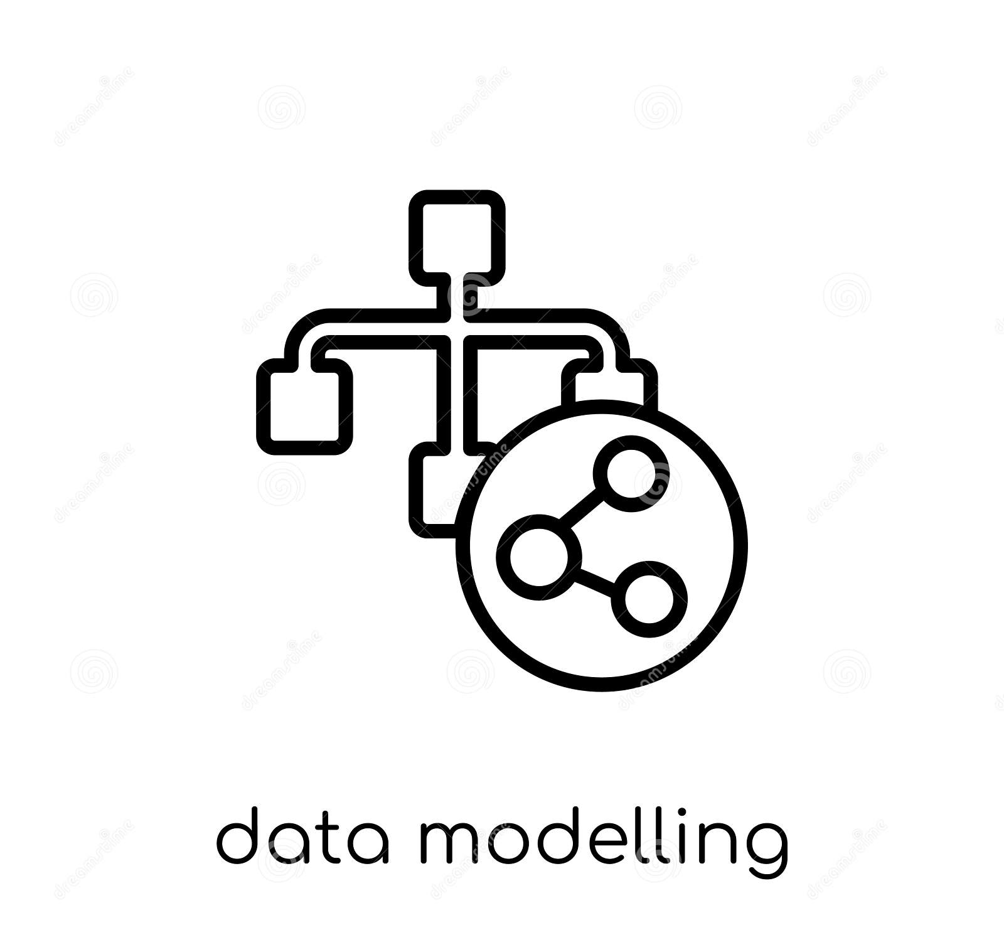
Model Development
The information gleaned from data exploration is then used to develop various behavioral models and also explore relationships among variables.
We have to perform statistical hypothesis testing as related to the business problem using the available data.
Test the performance of the model using statistics like residual deviance, R Squared for model fit, F stat for model significance, etc. in accordance with the assumptions of the model.

Slide 6
Interpretation
The information gleaned from the statistical modelling is then used to derive actionable conclusions. Also, we will employ visualizations to make the interpretation easier.
This may involve interpreting based on the statistical significance of individual variables. And also, the collective significance of the variables.
Various visualizations such as bar chart, cards, pie chart, etc. will be used to simplify the interpretation of various relationships

